Slide 1
Year 10 Parent Information Evening May 2022

Slide 2
Acknowledgement to Country
I respectfully acknowledge the past and present traditional custodians of this land on which we are meeting. I also acknowledge the contributions of Aboriginal Australians and non - Aboriginal Australians to the education of all children and people in this country we all live in and share together – Australia.

Slide 3
Year 10 Team Members
Deputy Year 10 & 11- Ms Amanda Letch
Student Services Manager- Ms Rosie Taylor
Pathways Coordinator- Mrs Alison Flockhart
Year 10 Coordinator- Mr Craig Thompson
Attendance Officer- Ms Sarah Martin
Tutorial Teachers- Mrs Emilie Burrows, Mr Grant Capes, Mr Clem Evans, Ms Lisa Gattuso,Mrs Sarah Johns, Ms Emily Sharp

Slide 4
Career Practitioner- Sarah Johns
Role of the Career Practitioner
Support for students and parents

Slide 5
5

Slide 6
Course Selection for 2023-24
Understanding WACE Requirements
OLNA Requirements
Good Standing
Pathways for Year 11/12 WACE Courses-ATAR, General, External Training Pathway
Benchmarks
Tutorial Program
Course Selection Process

Slide 7
Tutorial Program
Weekly lessons
Identify skills, interests and abilities
Identify pathways and options
Supports preparation for life beyond school

Slide 8
What are the pathway options for Year 10 students at the end of this year?
A APPLY for TAFE Full Time
B Sign up for an Apprenticeship
C Get a Full Time Job and leave school
D Return to school- choose appropriate
course

Slide 9
WACE- Western Australian Certificate of Education
Graduation – Western Australian Certificate of Education (WACE) Courses completed over Years 11 and 12
WACE Tracking
Good Standing
Prepare for transition to work, training or further education
Senior school courses
Vocational programs – incorporating Vocational Education and Training (VET)

Slide 10
WACE- Requirements
Complete a literacy and numeracy assessment to demonstrate achievement at or above a minimum standard- OLNA
Complete an ATAR course OR General courses in combination with a VET qualification
Foundation courses will be timetabled for students who have not met OLNA requirements for Maths and English
Complete a year 11 English course and year 12 English course
Complete at least one course from a List A (Arts, Language, Social Science)course and one course from a List B course (Mathematics, Science, Technologies)

Slide 11
WACE- Requirements
Complete a minimum of 10 courses across senior secondary years
Achieve at least 7 C Grades in year 11 and 12 (or equivalents)
AND
Achieve at least 3 C Grades in year 12 (or
equivalents) Completion of Certificates as part of their Senior School Course

Slide 12
Good Standing Policy- supports achievement of WACE
Good Standing is reviewed each semester. Students who are deemed to have maintained Good Standing in a semester will have achieved the following levels of performance in relation to the standards:
Commitment Standard- obtain at least 60% combined ‘Consistently’ and ‘Often’ attributes on Semester Report
Attendance Standard- 90% attendance (or better) within a semester
Conduct Standard- maintain what is accepted as consistent good conduct

Slide 13
Good Standing Policy
Advanced Standing – Academic
Students are deemed to have excelled in relation to the standards
Advanced Standing – Commitment
Students are deemed to have excelled in relation the standards

Slide 14
Good Standing Policy
Conditional Standing
Students are deemed to have performed below an acceptable level in relation to the standards when they have exhibited one or more of the following levels of performance in a semester:
Commitment Standard- obtain less than 60% combined Consistently and Often Attributes on Semester Report
Attendance Standards- below 90% attendance within a semester
Conduct Standard- not maintaining consistent good conduct across the school.

Slide 15
WACE- Pathways at BSC
ATAR Front door entry to University
GENERAL 5 Day Program at BSC
ETP 4 Day Program at BSC and access to External Training Providers Work Placement, TAFE, School Based Traineeships, Other External Training Providers

Slide 16
How to make a Good Decision when selecting Courses for 2023-24

Slide 17
Benchmarks- Requirements for choosing Pathways at BSC
NAPLAN Band 8 or above and B Grade in year 10 English for ENGLISH & Related Courses in ATAR Pathway
Pre- Requisites for other ATAR courses
General/Certificate courses have recommended benchmarks and some prerequisites for Attributes

Slide 18
Course Benchmarks 2023-24
ATAR students must have the benchmark for ATAR English to select any ATAR Course
Curriculum Area | Year 11 and Year 12 ATAR | Course Code | Year 10 minimum Benchmark Semester 1
English | English | AEENG | Band 8 NAPLAN Writing and Reading` and B English grade
Mathematics | Mathematics Applications | AEMAA | B Grade General Pathway Band 8 NAPLAN Numeracy minimum 60% in Maths Exam
 | Mathematical Methods- Round One offer | AEMAM | A Pre ATAR Pathway and minimum 70% in Maths Exam Band 8 NAPLAN Numeracy
Science | Psychology | AEPSY | B Grade in Science and B in Science Exam Band 8 NAPLAN Numeracy
 | Human Biology | AEHBY | B Grade in Science and B in Science Exam Band 8 NAPLAN Numeracy
 | Earth and Environmental Science | AEBLY | B Grade in Science and B in Science Exam Band 8 NAPLAN Numeracy
 | Chemistry | AECHE | B Grade Science and B in Science Exam Band 8 NAPLAN Numeracy
 | Physics- Round One offer | AEPHY | B Pre ATAR Pathway Grade and Qualify for Maths Methods and B in Science Exam Band 8 NAPLAN Numeracy
Health and Physical Education | Health Studies | AEHEA | Benchmark ATAR English and A in Health
Humanities and Social Sciences | Geography | AEGEO | Benchmark ATAR English and B HASS grade and minimum 60% in HASS Exam
 | Modern History | AEHIM | Benchmark ATAR English and B HASS grade and minimum 60% in HASS Exam
The Arts | Visual Arts- portfolio required | AEVAR | Benchmark for ATAR English and A in Year 10 Art

Slide 19
List A course List B course
Course Benchmarks 2022-23
General Courses/Certificates- recommended benchmarks
Curriculum Area | Year 11 and 12 General | Course Code | Year 10 minimum Benchmark Semester 1
English | English | GEENG | OLNA Requirements met
Mathematics | Mathematics Essential | GEMAE | OLNA Requirements met
Health and Physical Education | Physical Education Studies | GEPES | Minimum C Grade in Year 10 Physical Education
 | Health Studies | GEHEA | Minimum C Grade in Year 10 Health Education
 | Outdoor Education | GEOED | Minimum C Grade in Year 10 PE/OED/Sp Sci
The Arts | Visual Arts | GEVAR | Minimum C Grade in Year 10 Visual Arts 2D/3D
Technology and Enterprise | Food Science and Technology | GEFST | Minimum C Grade in Year 10 Food
 | Children, Family and Community | GECFC | Minimum C Grade in Child Care
 | Materials Design and Technology Metals | GEMDTM | Minimum C Grade in Year 10 Metalwork
 | Materials Design and Technology Wood | GEMDTW | Minimum C Grade in Year 10 Woodwork
Science | Human Biology | GEHBY | Minimum C Grade in Year 10 Science
Humanities and Social Sciences | Career and Enterprise | GECAE | Minimum C Grade in Year 10 HASS
 | Geography | GEGEO | Minimum C Grade in Year 10 HASS
 | Modern History | GEHIM | Minimum C Grade in Year 10 HASS
FOUNDATION COURSES - ONLY OFFERED TO STUDENTS WHO HAVE NOT MET OLNA REQUIREMENTS
English | English | FEENG
Mathematics | Mathematics | FEMAE
Humanities and Social Sciences | Career and Enterprise | FECAE
CERTIFICATE COURSES
 | Certificate II in Creative Industries | CUF20107 | Minimum C Grade in Year 10 Media
 | Certificate II in Construction | CPC20211 | Minimum C Grade in Woodwork/Metalwork
 | Certificate II in Hospitality | SIT20213 | Minimum C Grade in Year 10 Food
 | Certificate II in Community Services | CHG22015 | Minimum C Grade in Year 10 Child Care
 | Certificate II in Workplace Skills (Year 11) and Certificate III in Business (Year 12) | BSB20112 | Minimum C Grade in Year 10 English
 | Authority Developed Workplace Learning | ADWPL | Based on Good Standing Attributes

Slide 20
List A course List B course
What is V.E.T ? Vocational Education & Training
Training and demonstration of competencies by students
Nationally recognised qualifications
Qualifications range from Certificate I – Advanced Diploma

Slide 21
List A course List B course
Benefits of Vocational Education & Training
Saves approximately $2000 per TAFE Certificate by
completing them at school
More competitive to future training post school
Access to industry expertise & equipment
Links with employers and industry
Alternative university entry pathway

Slide 22
List A course List B course
Vocational Education & Training at BSC
General Program- 5 days at school
Choice of courses/certificates
Complete TAFE Certificates at school
External Training Pathway- 4 days at school
Package of courses at school with some choice
Exploration of Workplace

Slide 23
List A course List B course
Certificates and Endorsed programs delivered at BSC
Certificate II in Workplace Skills
Certificate III in Business (Year 12) if Cert II completed
Certificate II in Creative Industries
Certificate II in Construction
Certificate II in Hospitality
Certificate II in Community Services
Authority Developed Workplace Learning

Slide 24
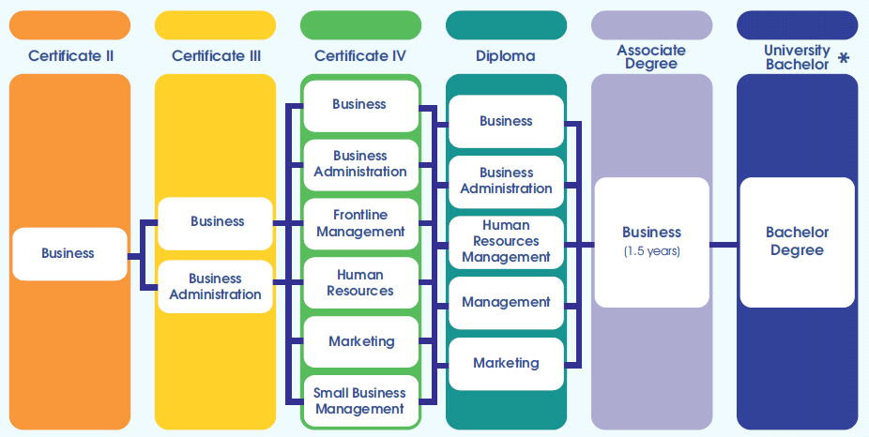
VET Certificate Pathways to TAFE or University

Slide 25
USI Numbers
A USI is your individual education number for life. It also gives you an online record of your VET training undertaken in Australia.
If you're at university, TAFE or doing other nationally recognised training, you need a USI. Without one, you can't get Commonwealth financial assistance or your qualification or statement of attainment
**Students need a USI number to be enrolled in a Certificate Course
www.usi.gov.au

Slide 26
List A course List B course
What is ATAR?
Australian Tertiary Admissions Rank
Australian Tertiary Admissions Rank
Nationally recognised ranking used for all universities
Scores from best 4 ATAR Courses used to calculate
Sit external exams at the end of Year 12
All students are ranked (70 ATAR = top 30%)
Minimum ATAR for university entrance = 70

Slide 27
List A course List B course
What is ATAR?
Australian Tertiary Admissions Rank
C/B grades ~ minimum 70 (Curtin, Murdoch and ECU)
B grades ~ minimum 75 (UWA)
A grades ~ 90+ (highly competitive courses) Physiotherapy, Law

Slide 28
List A course List B course
Why are the benchmarks a good guide to predict success in ATAR courses?

Slide 29
Progress of student with ATAR Benchmarks

Slide 30
Progress of student with ATAR Benchmarks
Term 1 Marks
English 66 B
Human Biology 79 A
Health Studies 91 A
Mathematics Applications 74 B
Physical Education Studies 71 B

Slide 31
Progress of student with ATAR Benchmarks
Final School Marks
English 66 B
Human Biology 79 A
Health Studies 91 A
Mathematics Applications 76 A
Physical Education Studies 76 A
ATAR SCORE 96.10- access to many competitive courses and scholarship offers

Slide 32
Progress of ATAR student who didn’t meet the benchmarks

Slide 33
Progress of ATAR student who didn’t meet the benchmarks
Term 1 Marks
English 43 D
Modern History 44 D
Health Studies 57 C
Mathematics Applications 51 C
Visual Arts 46 D

Slide 34
Progress of ATAR student who didn’t meet the benchmarks
Final School Marks
English D
Modern History D
Health Studies C
Mathematics Applications C
Visual Arts D
ATAR SCORE 58- Unable to access any University Courses

Slide 35
List A course List B course
University Pathway ATAR
What does it take?
Make study a priority, limited social life
Cutting back or giving up part time work
Fewer sporting commitments
Limited TV, internet, Social media and mobile phone use
Study academically demanding Courses (ATAR Courses)
Sit exams each semester in Yrs. 11/12
Sit external university entrance exams (achieve an ATAR ≥ 70 (minimum C/B grades)
Commitment to study for the next 5 – 7 years

Slide 36
List A course List B course
Non-University Pathway- General/External Training Provider - What does it take?
Expectation to complete all set tasks
Some homework, particularly if don’t complete class work
Study less academically challenging Courses (General Courses)
Complete VET Certificate/s
Sit tests and complete assignments
No exams- Sit the Externally Set Task in Year 12 which is 20% of the Final Mark
Attend one day/week away from school with an External Training Provider

Slide 37
List A course List B course
Important steps along the way before Course Selection
Tutorial lessons in Semester 1 to guide Course selection
Parent Interview Day- 4 May
Year 10 Careers Expo- 4 May
Year 10 Exams for students wanting to select ATAR- 25/26 May
Tutorial lesson- Practice Course Selection lesson
Year 10 Reports distributed end of Week 7- 10 June
Course Selection in Tutorial classes Week 8- 17 June. Students will bring home the Course Selection Sheet for signing. Return on Monday 20 June.
Parent interviews with Deputy for re-counselling if required

Slide 38
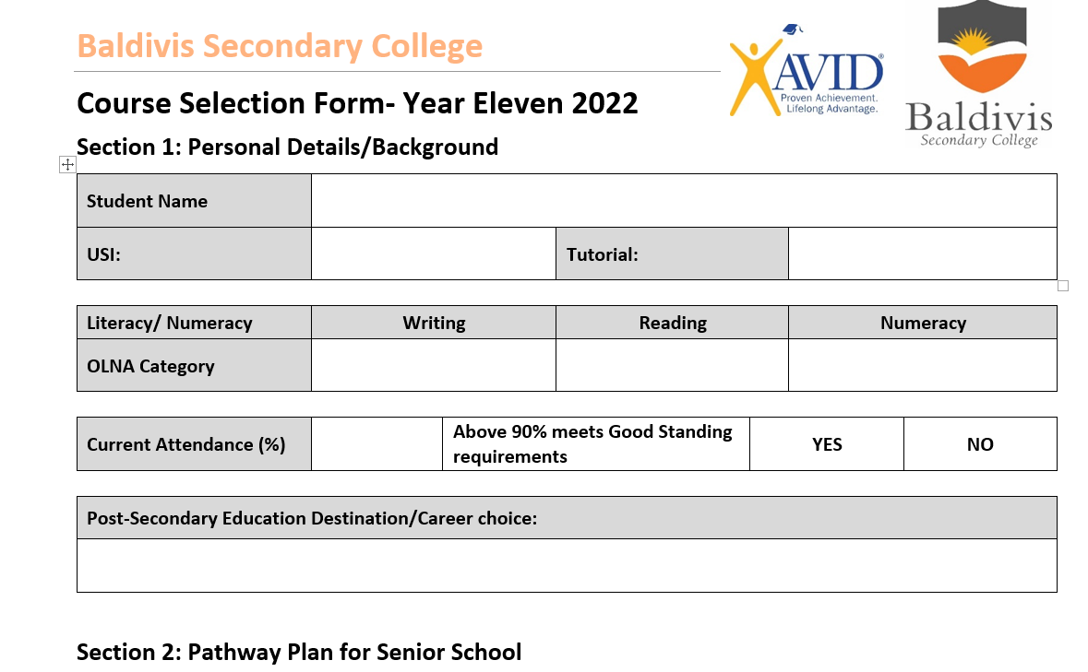
List A course List B course
Key Points for Course Selection

Slide 39
List A course List B course
Key points for Course Selection
Select 6 courses, one must be English
Choose at least 1 List A course and 1 List B course
ATAR PATHWAY – 4 ATAR Courses/1 General/1 VET Certificate
- 4 ATAR Courses/2 General
- 5 ATAR Courses/1 VET Certificate
- 5 ATAR Courses/1 General Course
- 6 ATAR Courses
Select 6 courses, one must be English
Choose at least 1 List A course and 1 List B course
ATAR PATHWAY - 5 ATAR Courses/1 General or 1 VET Certificate
Selections are made from the FIXED GRID on the Course Selection Form
You must Select Reserve Courses for ATAR and General in case a course does not run or there is a clash of courses in the Timetable

Slide 40
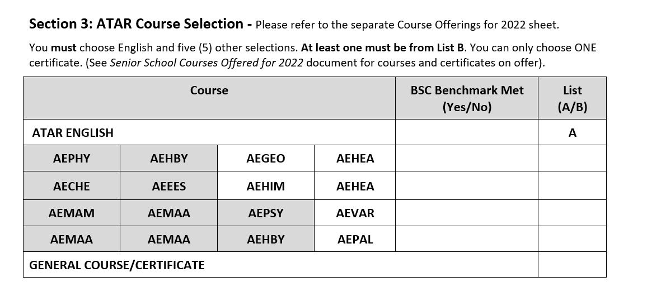
List A course List B course
Key points for Course Selection- ATAR
Select 6 courses, one must be English
Choose at least 1 List A course and 1 List B course
ATAR PATHWAY – 4 ATAR Courses/1 General/1 VET Certificate
- 4 ATAR Courses/2 General
- 5 ATAR Courses/1 VET Certificate
- 5 ATAR Courses/1 General Course
- 6 ATAR Courses
You must Select Reserve Courses for ATAR and General in case a course does not run or there is a clash of courses in the Timetable

Slide 41
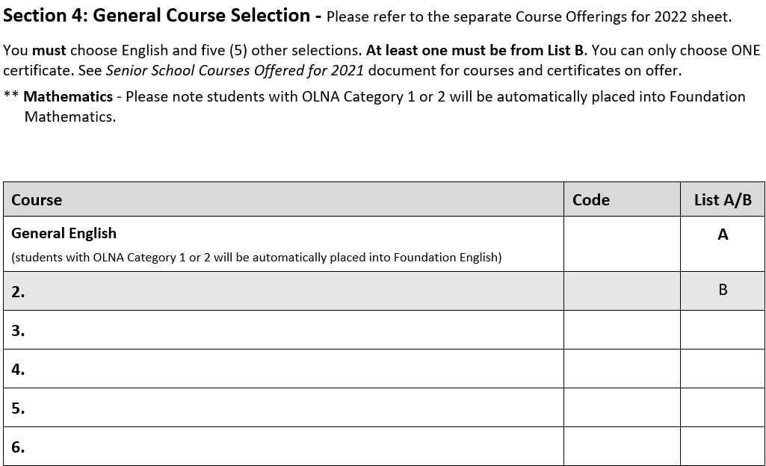
List A course List B course
Key points for Course Selection
You must Select Reserve Courses for General in case a course does not run or there is a clash of courses in the Timetable

Slide 42
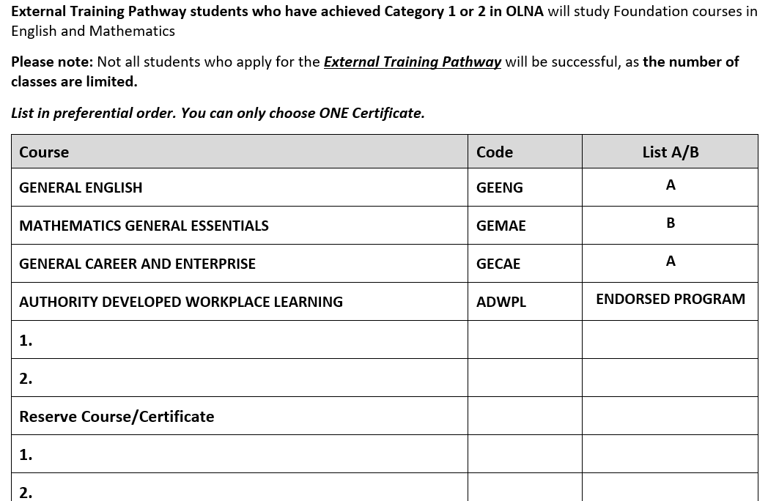
List A course List B course
Key points for Course Selection
You must Select Reserve Courses for General/Certificates in case a course does not run or there is a clash of courses in the Timetable

Slide 43
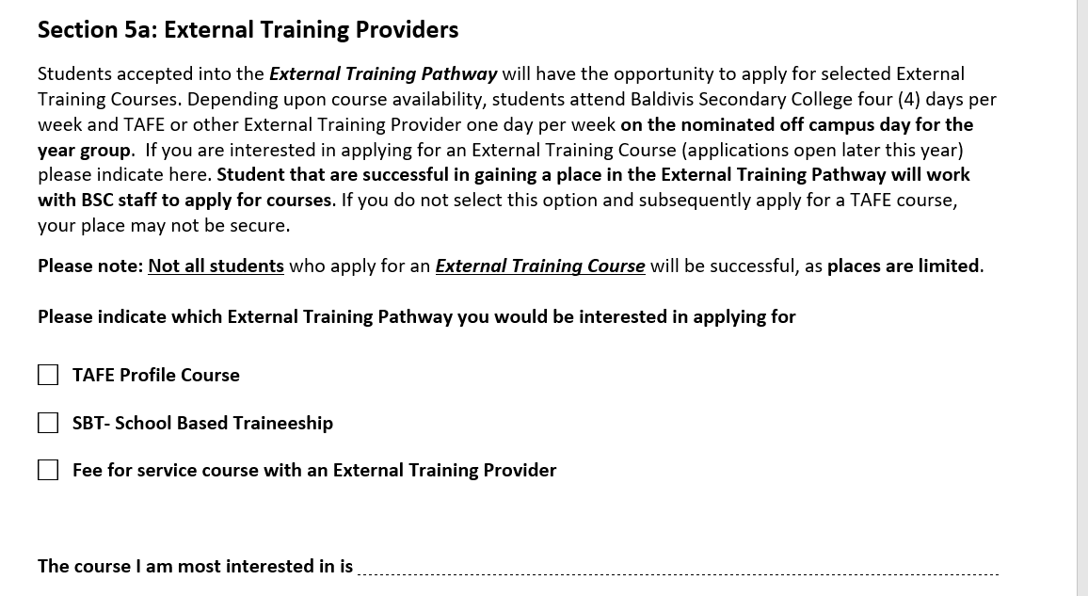
List A course List B course
Key points for Course Selection

Slide 44
List A course List B course
Key points for Course Selection

Slide 45
myfuture website- great resource for parents as well as students

Slide 46
Course Selection Handbook- online
Baldivis Secondary College Website
Home Page
Senior School Icon
Year 10 Course Selection Tab

